Slide 1
Criminal Justice Major for College: Victimology
Here is where your presentation begins

Slide 2
Contents of this template
You can delete this slide when you’re done editing the presentation
Fonts | To view this template correctly in PowerPoint, download and install the fonts we used
Used and alternative resources | An assortment of graphic resources that are suitable for use in this presentation
Thanks slide | You must keep it so that proper credits for our design are given
Colors | All the colors used in this presentation
Icons and infographic resources | These can be used in the template, and their size and color can be edited
Editable presentation theme | You can edit the master slides easily. For more info, click here
For more info:
SLIDESGO | SLIDESGO SCHOOL | FAQs
You can visit our sister projects:
FREEPIK | FLATICON | STORYSET | WEPIK | VIDEVO

Slide 3
Table of contents
01
02
03
04
What is victimology and what does it study?
You can describe the topic of the section here
Types of victims
You can describe the topic of the section here
Crime and victims
You can describe the topic of the section here
Victimology and other disciplines
You can describe the topic of the section here

Slide 4
Whoa!
This can be the part of the presentation where you introduce yourself, write your email…

Slide 5
01
What is victimology and what does it study?
You can enter a subtitle here if you need it

Slide 6
What is victimology?
Mercury is the closest planet to the Sun and the smallest one in the entire Solar System. This planet's name has nothing to do with the liquid metal, since Mercury was named after the Roman messenger god. Its temperatures aren't as terribly hot as that planet's
Mercury takes a little more than 58 days to complete its rotation, so try to imagine how long days must be there! Since the temperatures are so extreme, albeit not as extreme as in Venus, Mercury has been deemed to be non-habitable for humans

Slide 7

When and where victimology emerges?
Do you know what helps you make your point crystal clear? Lists like this one:
They’re simple
You can organize your ideas clearly
You’ll never forget to buy milk!
And the most important thing: the audience won’t miss the point of your presentation

Slide 8
Scientific discipline that focuses on the study of
The victim
His relatives
Mercury is the closest planet to the Sun and the smallest one in the Solar System—it’s only a bit larger than the Moon
Venus has a beautiful name and is the second planet from the Sun. It’s hot and has a poisonous atmosphere

Slide 9
Why is it important to study the victim?
Mercury
Venus
Mars
Mercury is the closest planet to the Sun and the smallest of them all
Venus has a beautiful name and is the second planet from the Sun
Despite being red, Mars is actually a cold place. It’s full of iron oxide dust

Slide 10
Vulnerability factors
Personality elements
Social
factors
Venus is the second planet from the Sun
Jupiter is the biggest planet in the Solar System
Environmental elements
Employment
issues
Despite being red, Mars is a cold place
Saturn is a gas giant and has several rings

Slide 11
Risk factors
Age
Gender
Status
Despite being red, Mars is actually a cold place
Venus is the second planet from the Sun
Neptune is the farthest planet from the Sun
Family environment
The role in society
Individual features
Mercury is the closest planet to the Sun
Saturn is a gas giant with several rings
Jupiter is the biggest planet of them all

Slide 12
Awesome words

Slide 13
—Someone Famous
“This is a quote, words full of wisdom that someone important said and can make the reader get inspired.”

Slide 14

A picture is worth a thousand words

Slide 15
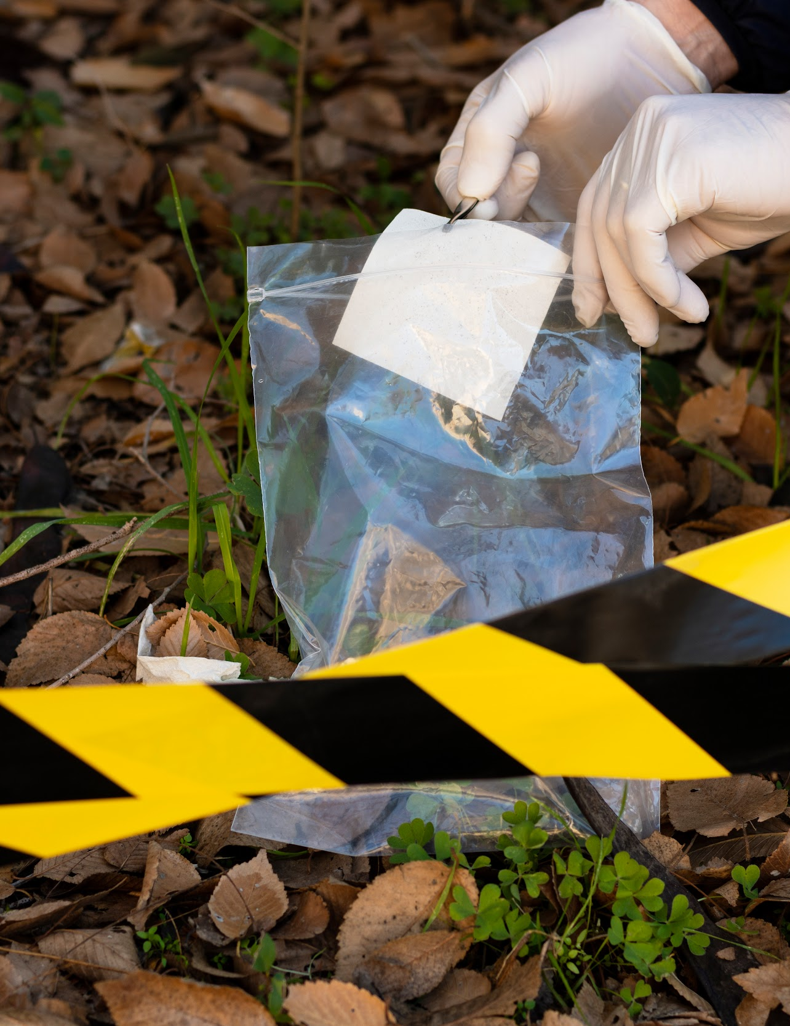
A picture always reinforces
the concept
Images reveal large amounts of data, so remember: use an image instead of a long text. Your audience will appreciate it

Slide 16
4,498,000
Big numbers catch your audience’s attention

Slide 17
35M
25M
23K
Mars is full of iron oxide dust
The Sun’s mass compared to Earth’s
Distance between Earth and the Moon

Slide 18
World's most common victims
25%
50%
75%
Human trafficking
Homicide victims
Shootings victims
Jupiter is the biggest planet of them all
Neptune is far away from Earth
Venus is the second planet from the Sun

Slide 19

Desktop software
You can replace the image on the screen with your own work. Just right-click on it and select “Replace image”

Slide 20
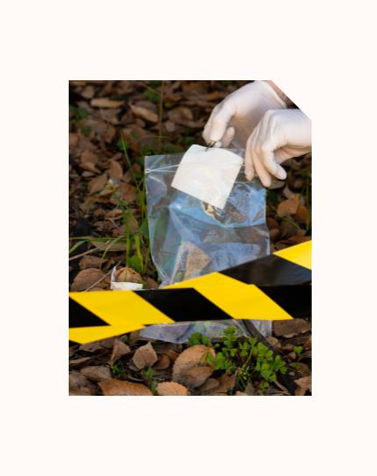
Tablet
app
You can replace the image on the screen with your own work. Just right-click on it and select “Replace image”

Slide 21
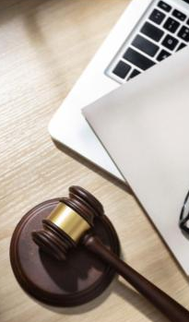
Movil
app
You can replace the image on the screen with your own work. Just right-click on it and select “Replace image”

Slide 22
Countries with more crime victims
88%
Afghanistan
Jupiter is the biggest planet of them all
65%
Burkina Faso
Neptune is far away from Earth
55%
Mali
Mars is actually a very cold place

Slide 23
Victimology history
Venus has a beautiful name and is the second planet from the Sun. It’s terribly hot, even hotter than Mercury
02
Mercury is the closest planet to the Sun and the smallest one in the Solar System. Neptune is very far away from us
04
Despite being red, Mars is actually a very cold place. It’s full of iron oxide dust, which gives the planet its reddish cast
Neptune is the farthest planet from the Sun. The Moon is Earth’s only natural satellite. We all live on Earth
01
03

Slide 24
Desvictimization process
The victim's family members
The criminal justice system
Psychologists
The media
The police
Victim support associations

Slide 25
Classification of victims
Types | Characteristics
Primary victimization | The person suffers physical or psychological damage as a result of the event, either directly or indirectly
Secondary victimization | It is the personal impact that the person receives for participating in a criminal event. For example, having to relive the event that he/she had again for testifying before the law
Tertiary victimization | The person who commits the crime may also be a victim of other processes, as well as the people closest to him/her

Slide 26
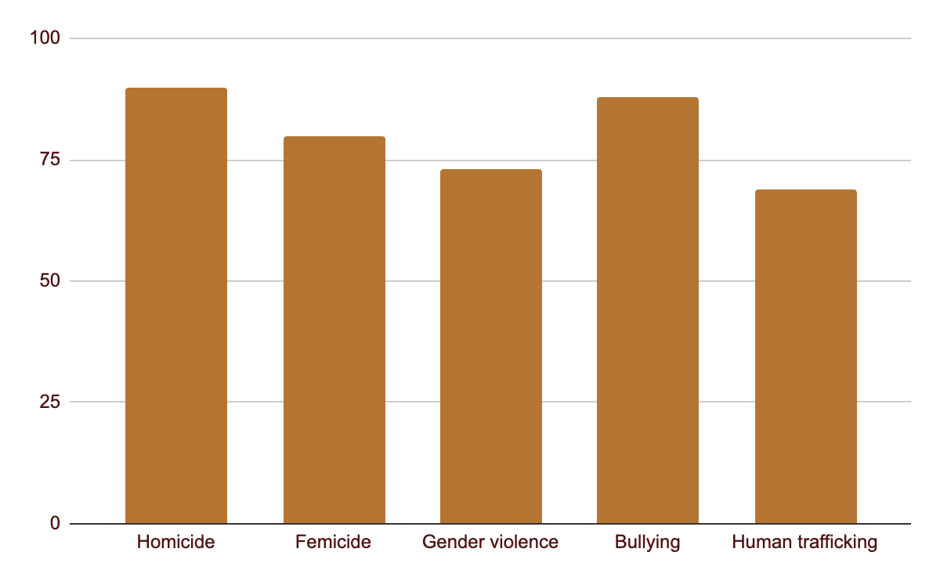
Deaths per victim in the world
90%
Victims of homicide deaths in the world
73%
Victims of gender violence in the world
Follow the link in the graph to modify its data and then paste the new one here. For more info, click here

Slide 27


Our team
Sofia Hillen
Dave Harris
You can speak a bit about this person here
You can speak a bit about this person here

Slide 28
04
Victimology and other disciplines
You can enter a subtitle here if you need it

Slide 29
Victim data sheet
Interview your victim and fill in the blanks with real and synthesized information
Victim profile
Name | Gender | Age
Behavior of the aggressor | Attitude of the victim | Relationship with the aggressor
Damages and the time | Place of the crime | Other details

Slide 30
Steps to follow to prepare a report
Fill in each step with the information collected
Victim identification
You can write here
Reason for expertise
You can write here
Objective of the expert report
You can write here
Summary of the facts
You can write here

Slide 31
Ethical precautions
Write down the precautions to be taken at each stage of the process
Victim of a crime
Saturn is a gas giant and has several rings. It's composed mostly of hydrogen and helium
Suffering from the crime
Investigation process
Consequences of the crime

Slide 32
Victim compensation
Mars
Neptune
Mars is actually a very cold place
Neptune is the farthest planet from the Sun
Mercury
Saturn
Jupiter
Mercury is the closest planet to the Sun
Saturn is a gas giant with several rings
Jupiter is the biggest planet of them all

Slide 33
Victimization surveys
Mark with an x Yes or No the questions you think are the right questions to ask a victim
Questions for the victim | Yes | No
Do you feel you are a victim of a crime? | x
You have been the one to blame for the damage done to the...
Do you consider that your actions have been favorable or unfavorable to the situation?
Have you felt marginalized during the interrogation process?
Do you have family or friends to talk to about how you feel about this situation?
Do you feel you are responsible for your actions and/or feelings?
Have your actions caused collateral damage to other people?

Slide 34
Final conclusions
The field of victimology includes a large number of disciplines or subjects, such as: Criminology, Sociology, Psychology or Criminal Law
Victimology is concerned with studying, identifying and explaining the phenomena that arise from the interaction of the victim with the crime
A multidisciplinary study should be carried out before and after the crime of relevant factors, such as psychological, social, economic and other studies, to understand the crime from a proportional perspective

Slide 35
Thanks!
Do you have any questions?
youremail@freepik.com | +34 654 321 432
yourwebsite.com
Please keep this slide for attribution

Slide 36
Alternative resources
Here’s an assortment of alternative resources whose style fits the one of this template:
Vectors:
Free vector gradient luxury law firm infographic

Slide 37
Resources
Did you like the resources on this template? Get them for free at our other websites:
Vectors:
Free vector gradient luxury law firm instagram posts
Photos:
Top view over career guidance items for judges
Free photo businessman and businesswoman sitting in front of manager at workplace
Truth concept arrangement at a crime scene
Front view of elegant businesswoman holding clipboard with copy space
Free photo businessman next to white board

Slide 38
Instructions for use
If you have a free account, in order to use this template, you must credit Slidesgo by keeping the Thanks slide. Please refer to the next slide to read the instructions for premium users.
As a Free user, you are allowed to:
Modify this template.
Use it for both personal and commercial projects.
You are not allowed to:
Sublicense, sell or rent any of Slidesgo Content (or a modified version of Slidesgo Content).
Distribute Slidesgo Content unless it has been expressly authorized by Slidesgo.
Include Slidesgo Content in an online or offline database or file.
Offer Slidesgo templates (or modified versions of Slidesgo templates) for download.
Acquire the copyright of Slidesgo Content.
For more information about editing slides, please read our FAQs or visit our blog:
https://slidesgo.com/faqs and https://slidesgo.com/slidesgo-school

Slide 39
Instructions for use (premium users)
As a Premium user, you can use this template without attributing Slidesgo or keeping the "Thanks" slide.
You are allowed to:
Modify this template.
Use it for both personal and commercial purposes.
Hide or delete the “Thanks” slide and the mention to Slidesgo in the credits.
Share this template in an editable format with people who are not part of your team.
You are not allowed to:
Sublicense, sell or rent this Slidesgo Template (or a modified version of this Slidesgo Template).
Distribute this Slidesgo Template (or a modified version of this Slidesgo Template) or include it in a database or in any other product or service that offers downloadable images, icons or presentations that may be subject to distribution or resale.
Use any of the elements that are part of this Slidesgo Template in an isolated and separated way from this Template.
Register any of the elements that are part of this template as a trademark or logo, or register it as a work in an intellectual property registry or similar.
For more information about editing slides, please read our FAQs or visit our blog:
https://slidesgo.com/faqs and https://slidesgo.com/slidesgo-school

Slide 40
Fonts & colors used
This presentation has been made using the following fonts:
Baskervville
(https://fonts.google.com/specimen/Baskervville)
Albert Sans
(https://fonts.google.com/specimen/Albert+Sans)
#fffaf7
#501010
#b47532
#790000
#ffe88c
#fce4c8

Slide 41

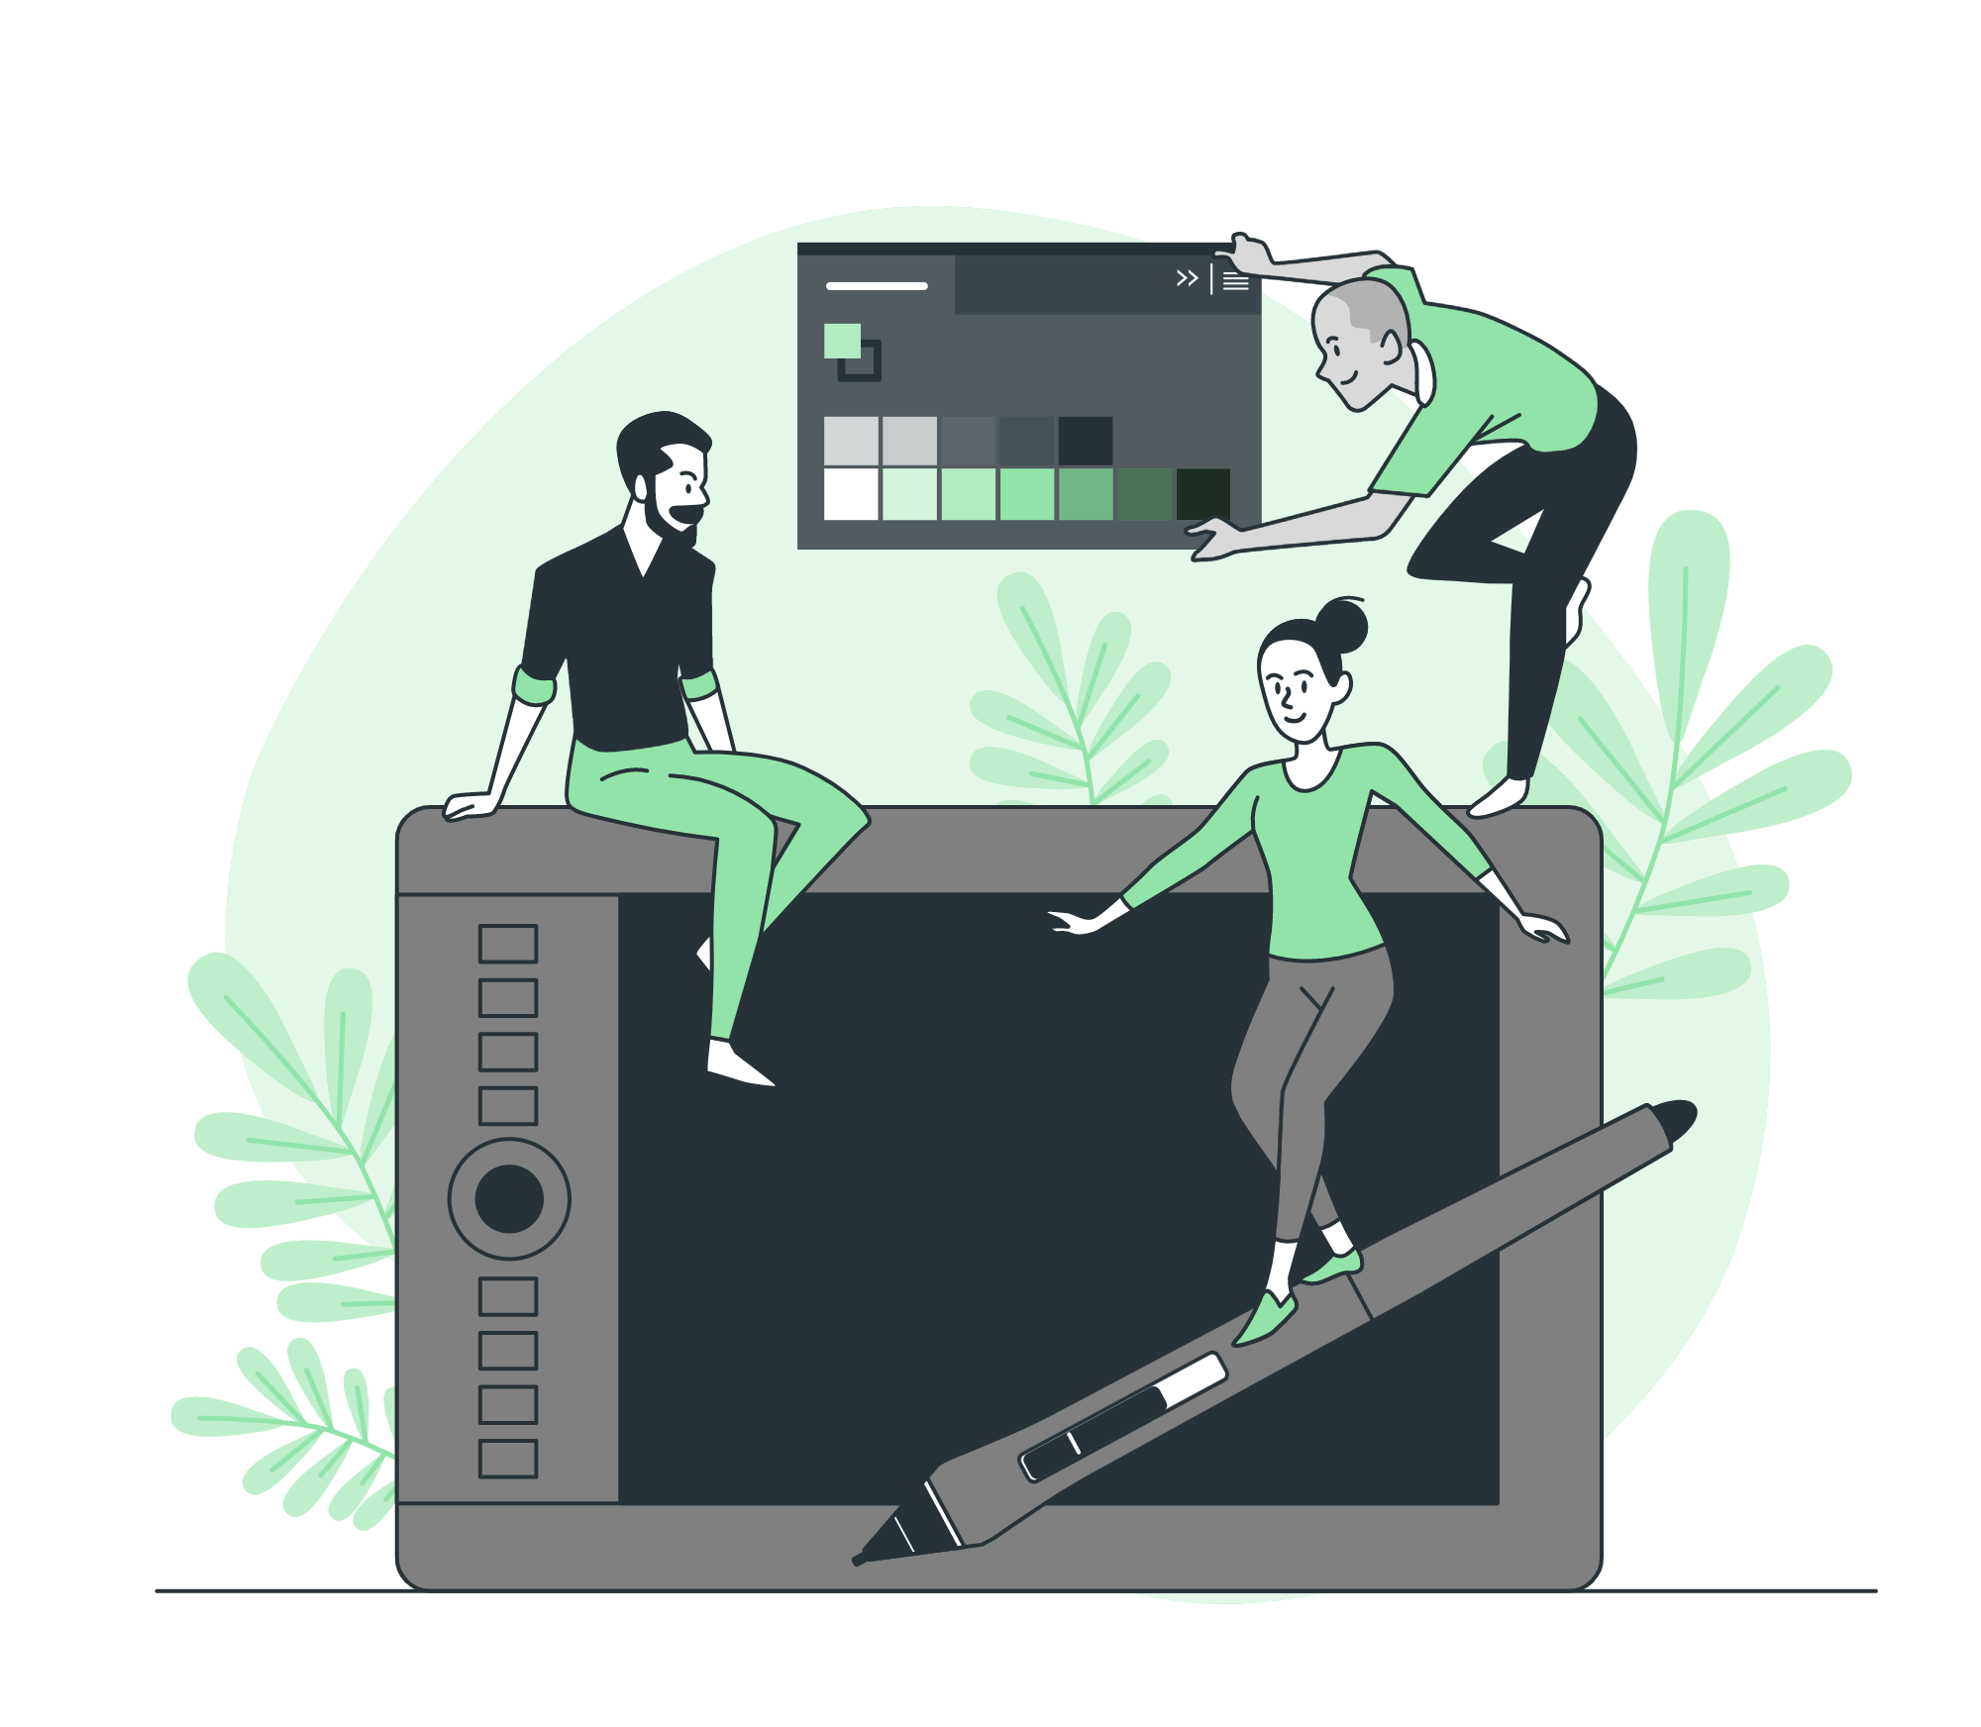

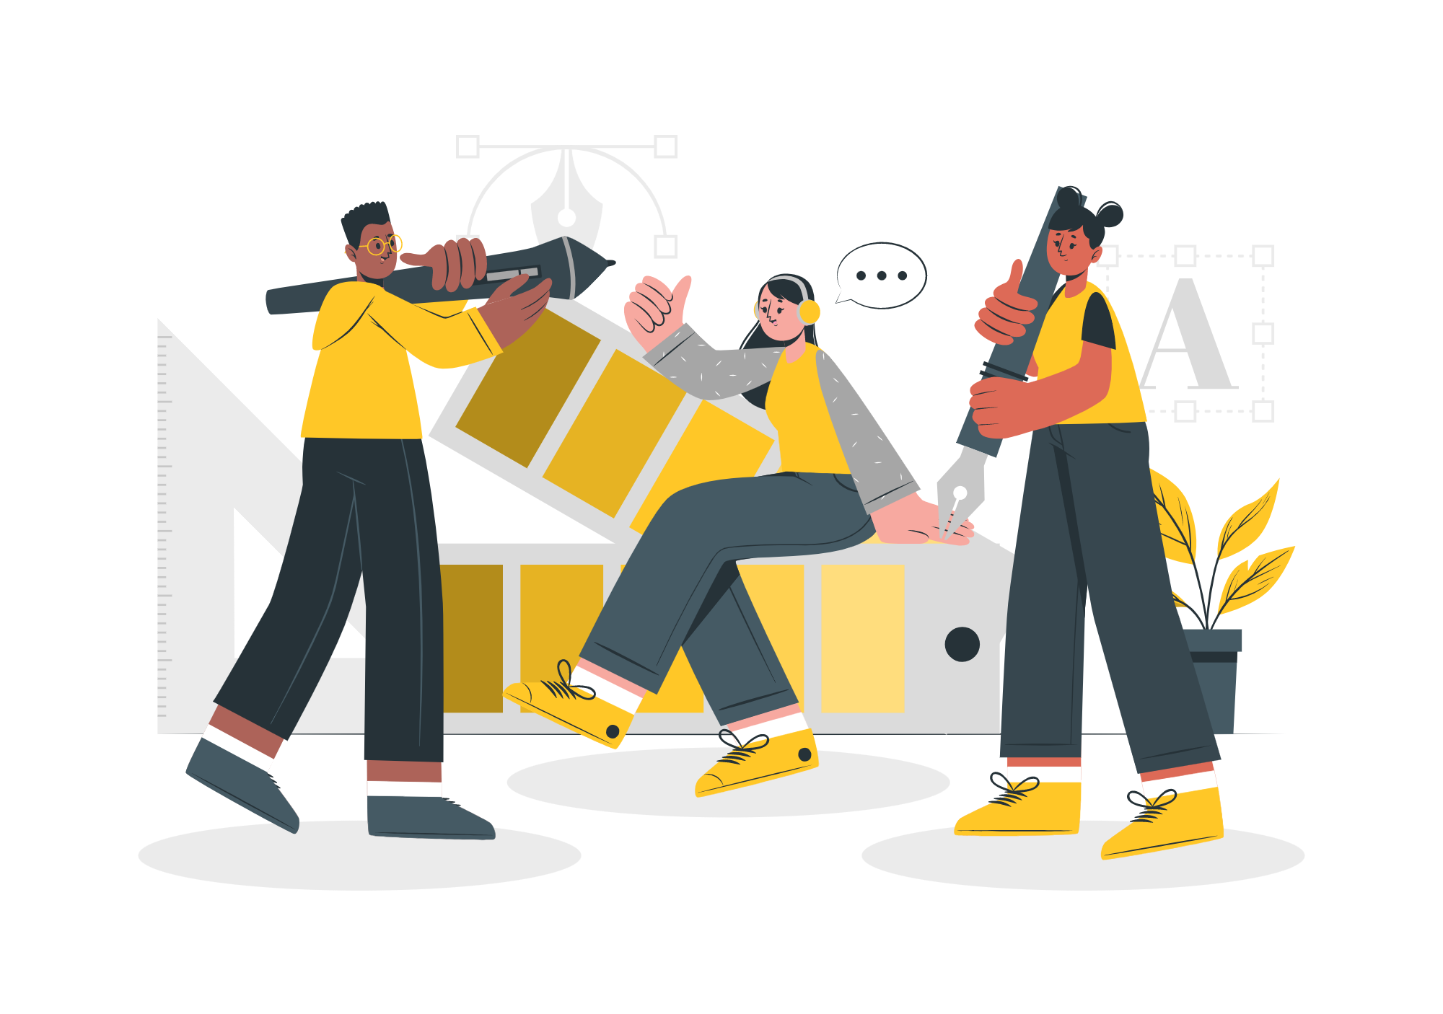

Storyset
Create your Story with our illustrated concepts. Choose the style you like the most, edit its colors, pick the background and layers you want to show and bring them to life with the animator panel! It will boost your presentation. Check out how it works.
Pana
Amico
Bro
Rafiki
Cuate

Slide 42
Use our editable graphic resources...
You can easily resize these resources without losing quality. To change the color, just ungroup the resource and click on the object you want to change. Then, click on the paint bucket and select the color you want. Group the resource again when you’re done. You can also look for more infographics on Slidesgo.

Slide 45
JANUARY
FEBRUARY
MARCH
APRIL
MAY
JUNE
PHASE 1
Task 1
Task 2
PHASE 2
Task 1
Task 2
JANUARY
FEBRUARY
MARCH
APRIL
PHASE 1
Task 1
Task 2

Slide 48
...and our sets of editable icons
You can resize these icons without losing quality.
You can change the stroke and fill color; just select the icon and click on the paint bucket/pen.
In Google Slides, you can also use Flaticon’s extension, allowing you to customize and add even more icons.

Slide 49
Educational Icons
Medical Icons

Slide 50
Business Icons
Teamwork Icons

Slide 51
Help & Support Icons
Avatar Icons

Slide 52
Creative Process Icons
Performing Arts Icons

Slide 53
Nature Icons

Slide 54
SEO & Marketing Icons

Slide 55


